Slide 1
I seen it
You can’t seen anything
Say: I saw it or I have seen it

Slide 2
Anyway
.
There is no S at the end of this word, so do not add one

Slide 3
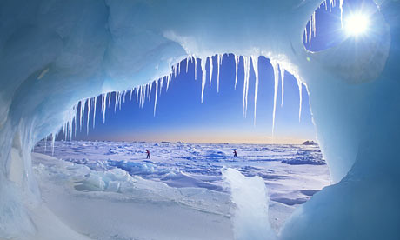
arctic
Note the C after the R
ARK-TIK/, not /ar-tik/.

Slide 4
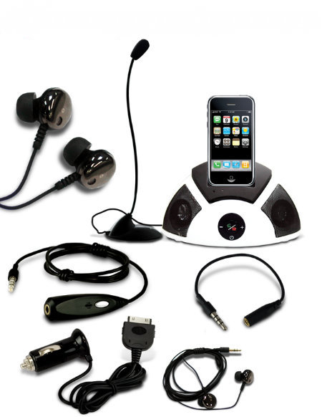
accessory
the first C has a “hard” sound.
Say /AK-SESS-OR-Y/

Slide 5
ask
The S comes before the K
. Say /ASK/ not /aks/.

Slide 6
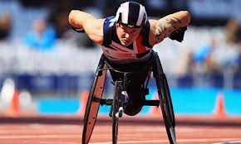
athlete
The word has two syllables, not three.
Say /ATH-LETE/,

Slide 7
cache
KASH/, not /ka-shay/

Slide 8
candidate
Notice the first d.
Say /KAN-DI-DATE/

Slide 9
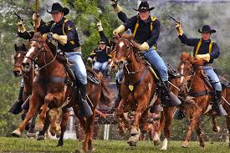
cavalry
Say /KAV-UL-RY/, not /kal-vuh-ry/

Slide 10
chaos
/KAY-OS/

Slide 11
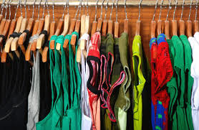
clothes
/KLOTHZ/, not /kloz/.

Slide 12
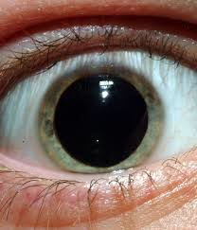
dilate
DI-LATE/, not /di-a-late/.

Slide 13
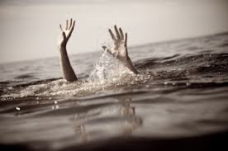
drowned
DROWND/, not /drown-ded/.

Slide 14
et cetera
/ET CET-ER-A/, not /ex cet-er-a/.

Slide 15
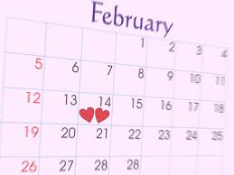
February
FEB-ROO-AR-Y/, not /feb-u-ar-y/.

Slide 16
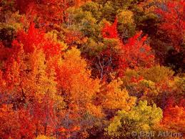
foliage
FO-LI-UJ/, not /fol-uj/.

Slide 17
forte
FOR-TAY not FORT

Slide 18
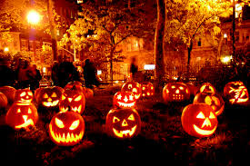
Halloween
/HAL-O-WEEN/, not /hol-lo-ween/.

Slide 19
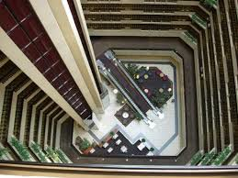
height
HITE/, not /hith/

Slide 20
hierarchy
HI -ER-AR-KY,/ not /hi-ar-ky/

Slide 21
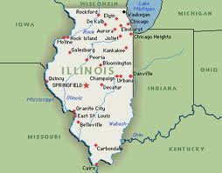
Illinois
IL-I-NOY not IL-LI-NOIZ

Slide 22
irregardless
Is not a word, say REGARDLESS

Slide 23
library
/LI-BRAR-Y/, not /li-ber-ry/.

Slide 24
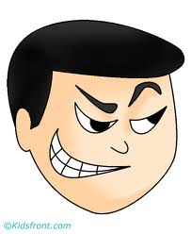
Mischievous
MIS-CHI-VUS/. Don’t say /mis-chee-vee-us/.

Slide 25
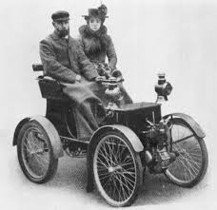
old-fashioned
/OLD-FASHIOND/, not /old-fashion/.

