Slide 1
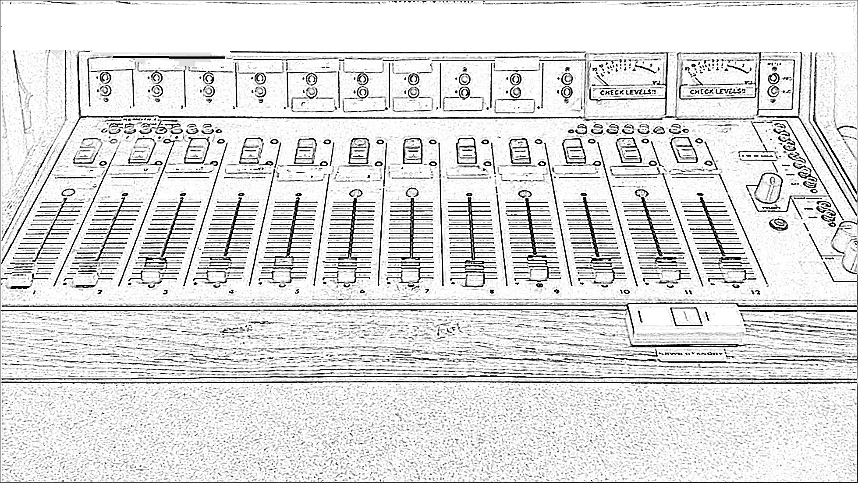

Slide 2
What is this

Slide 3
What are the steps for using it

Slide 4
What is this?

Slide 5
What are the steps for using it?

