Slide 1
Exile Radio WPHS, 89.1 FM
Student Staff positions
2013-2014

Slide 2
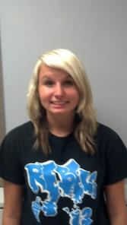
Program Director
Shelby Jones
The highest ranking student-staff member, the PD is responsible for the overall on-air product at WPHS.
The PD...
Select Shows & Events to cover
Gives feedback to on-air personnel
Coordinates other staff members
Works closely with management
Cross-checks and selects music

Slide 3
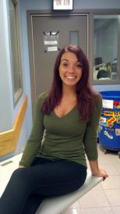
Community Affairs Director
Gianna Petz
Connects the station to the community through outreach efforts.
Community Affairs...
Plans events & on-air coverage for community groups and non-profits
Selects & programs PSAs for use on WPHS
Maintains & updates our public file (FCC required)
Looks for grants and other funding opportunities

Slide 4
Office Manager
Leah Silvestri
Maintains an efficient workplace at WPHS
Office Manager...
Looks for upgrades that give Exile Radio a more professional look
Establishes procedures for workplace safety and efficiency
Organizes tours for parents and community members

Slide 5
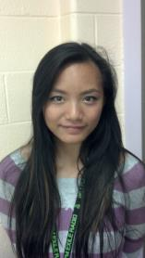
Music Director
Mia Denis
Selects & programs a majority of the music programming for Exile Radio
Music Director...
Picks all new College Rock that airs during “school shows” & automation hours
Sends “dirty” music to Production for editing
Maintains industry contacts with music labels
Gives music to specialty shows that need it

Slide 6
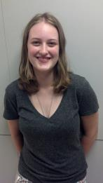
Hip-Hop Director
Nicole Gorman
Programs Hip-Hop music segments on Exile Radio
Hip-Hop Director...
Picks all new Hip-Hop that airs during “school shows” & automation hours
Maintains industry contacts with Hip-Hop music labels
Works closely with the Music Director at WPHS

Slide 7
Promotions Director
Jordan Harris
Promotes the station in the school and community at large
Promotion Director...
Designs “off-air” items for giveaway and sale (t-shirts, posters, buttons, and stickers)
Packages SWAG for giveaway during shows
Consults with Production on imaging and other on-air elements
Pushes our location broadcasts
Organizes the Exile Radio street team

Slide 8
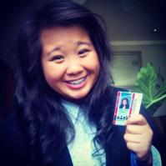
News Director
Rachel Hang
Provides local news coverage for Exile Radio
News Director...
Develops & maintains an assignment board for reporters to cover
Prepares “donuts” and “actualities” for air during “school shows”
Selects larger live events to cover (eg., Mayor’s State of the City Address, etc).

Slide 9
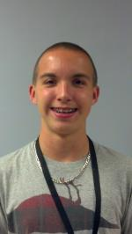
Sports Director
Justin Valentine
Covers local sporting events for Exile Radio
Sports Director...
Selects games to broadcast
Does Play-by-Play for select games
Picks “experts” for Color Commentating
Covers Cousino, Mott & Sterling... Boys & Girls sports

Slide 10
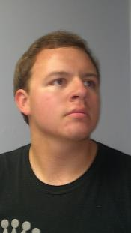
Production Director
Nick Cleyman
Creates recorded elements for Exile Radio
Production Director...
Is an expert and editing on Adobe Audition
Creates many of the most complicated production pieces on WPHS
Assigns projects to other personnel for recording
Works closely with the Head Writer and Promotions

Slide 11
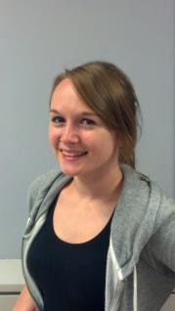
Head Writer
Mackenzie Rogers
Writes scripts for WPHS
Head Writer...
Writes scripts for production and live-read
Takes dry concepts and makes them breathe
Expert in Theater of the Mind
Produces elements for the Production Department
Works closely with the Production Director

Slide 12
Engineer
Chris Masi
Keeps the equipment running at WPHS
The Engineer...
Identifies and repairs broken equipment
If it can’t be fixed-
Recommends for repair by Chief Engineer (adult/contract)
Recommends for replacement
Installs new equipment
Demonstrates proper use to Radio 1/2 students

Slide 13
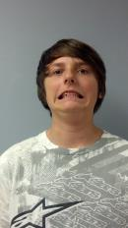
Head Detective
Alex James
Protects the 5th Estate
Head Detective...
Hunts down & turns-in anyone that breaks the rules

Slide 14
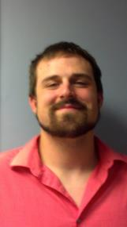
The Adults
Mr. Olstyn – Radio 1, 2/3 Teacher/General Manager
S – Radio 1 Teacher
Stefan – Radio Parapro/Operations Manager

Slide 15
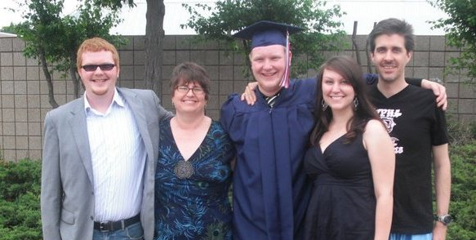
End...

